Slide 1
Team Stats 2 Crew
DDS Case Study 1: Beers and Breweries

Slide 2
Deliverables
Met with client to review Brewery data and ensure quality
After team did some investigation generated findings and recommendations for future implementation
Spatially correlated available data for high level review
Determined which Beers exhibited certain values for Alcohol by volume (ABV) and International Bitterness Units (IBU)

Slide 3
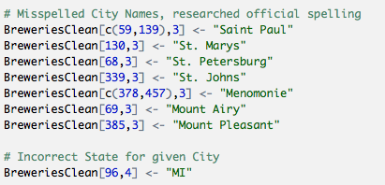
Data Investigation: Breweries
While reviewing the Breweries data set it appeared that duplicates could exist. Via base R sorting and text functions cleanup of City spellings and duplicated Brewery names was done. In particular we found that City names containing “St” were missing “.” and others had “Mt.” rather than “Mount”. Google search was used to verify Names. One name was misspelled twice, Menomonie in WI. It was also found that City name ”Marquette” was not found in MA, only in MI.

Slide 4
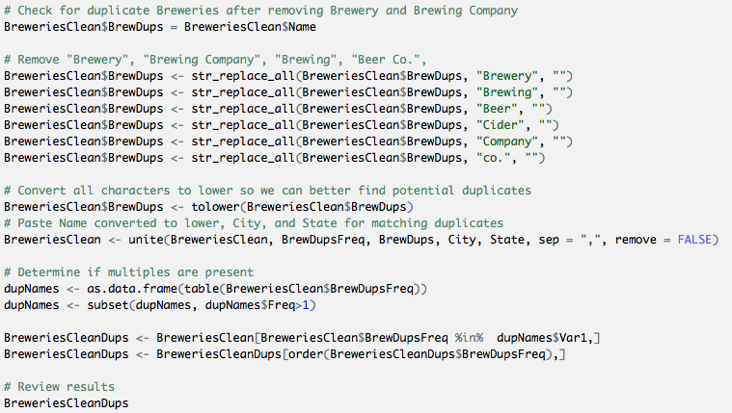
Data Investigation: Breweries
To better identify what could truly be duplicated rows, a combination of an adjusted Name, City, and State was used to determine frequency of occurrence. If that value was greater than 1 further investigation was necessary.

Slide 5
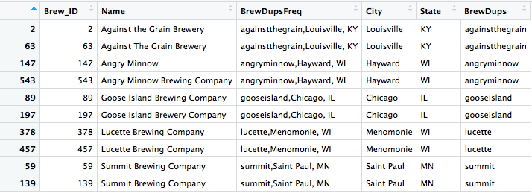
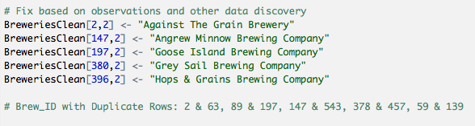
Data Investigation: Breweries
Even with these handy functions we still had to find a few more issues visually within the data. Those were slightly more difficult to find given slight differences in spelling or other special scenarios…
Too close to call, will leave as is

Slide 6
Technical Recommendations for Higher Quality Data
Database layer validations
Validate uniqueness of names of beers and breweries
Have States set as Enums
Build a web application to collect and verify data
Since we are not working with Big Data here, it would be good to have tooling in place to have api integration with Google maps api to verify name and address of breweries.
This application can have more sophisticated validation logic
This application can leverage task scheduling to pull data
Consume data in many formats. CSV, JSON, XML, etc.

Slide 7
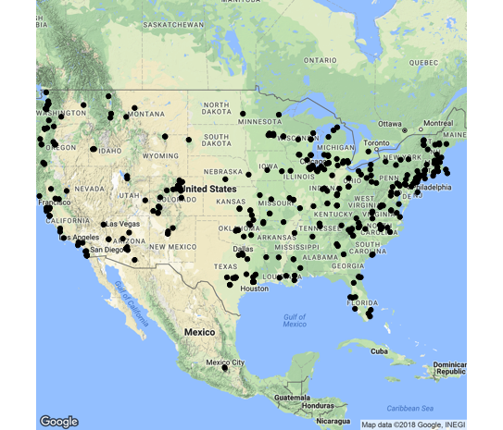
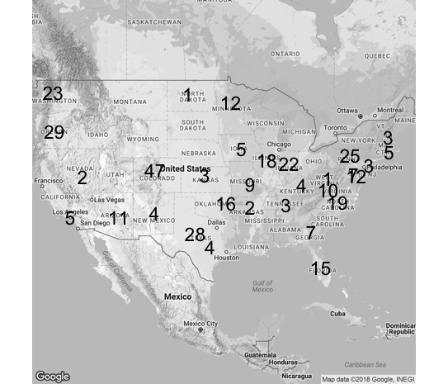
Spatial Results
Locations by City, State
Count by Region

